Slide 1

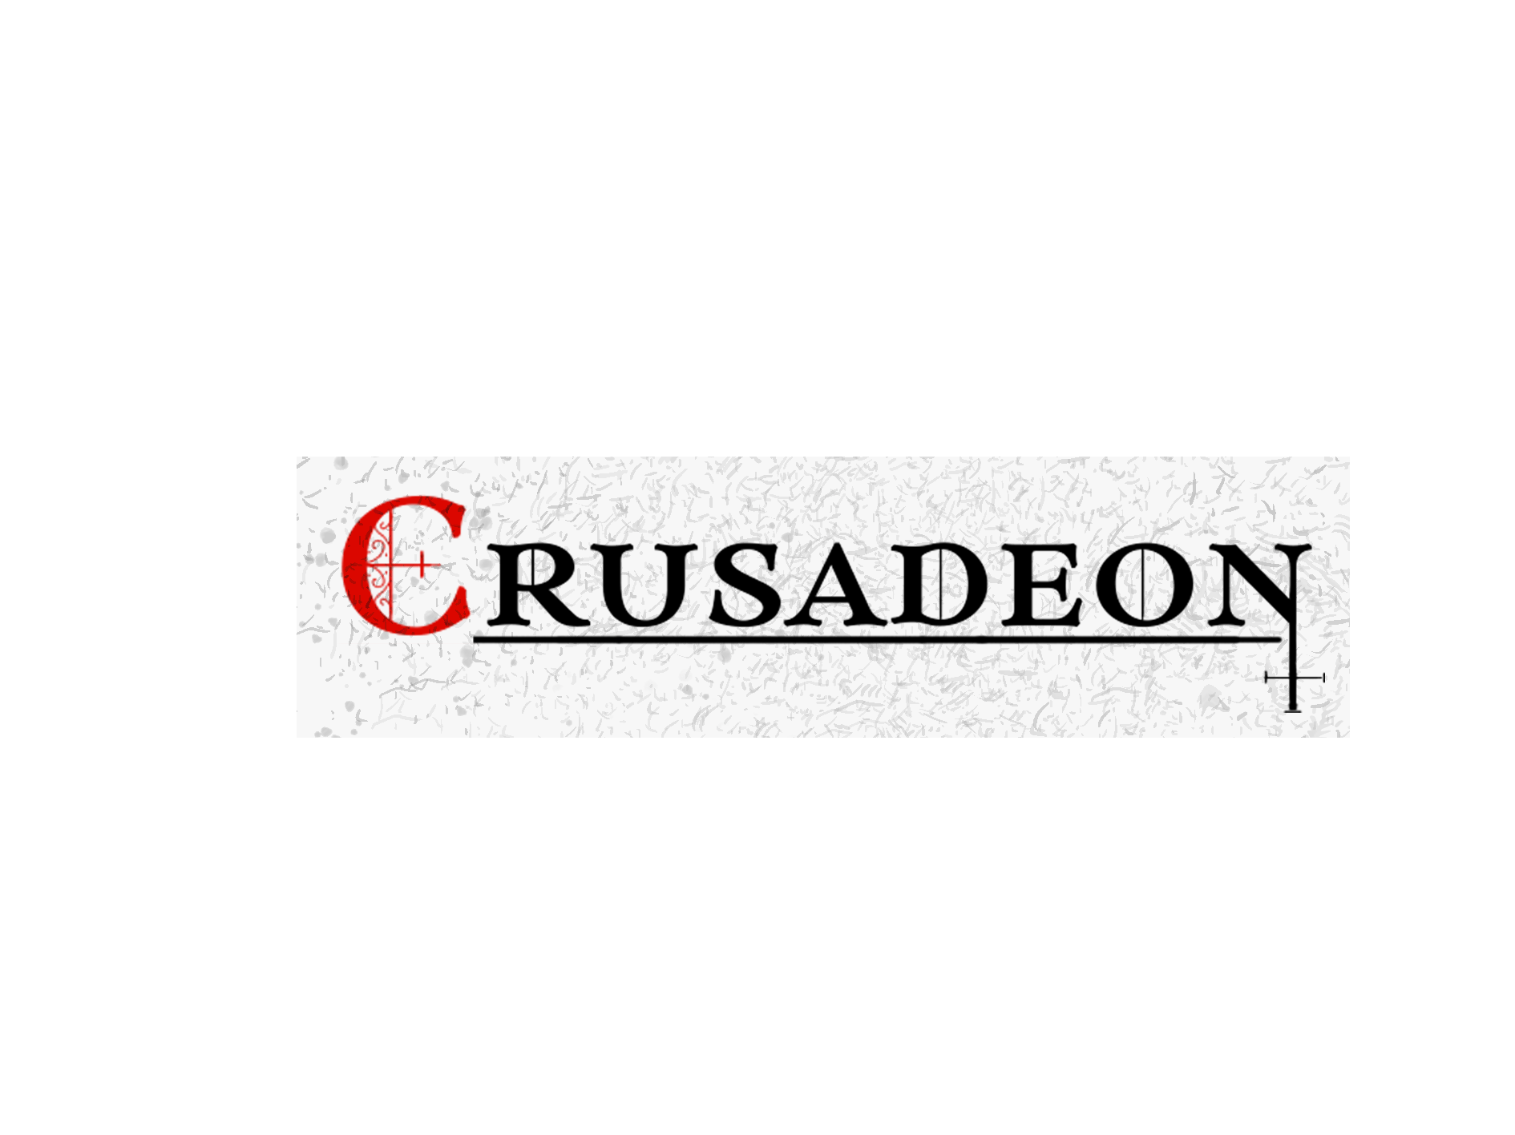

Presented by

Slide 2
Agenda
Introduction to team
Summary of Crusadeon
Design challenge
Story
Level design
Inspirations for combat & item/skill progression

Slide 3






The Team
Creative Director
Master of the Frames
Scrum Master
Davey van den Eijnde
Nathan Thus
Sander Noordzij
Programmer
Programmer
Artist
Tim Meijvogel
Paul Jutte
Willem de Vries

Slide 4
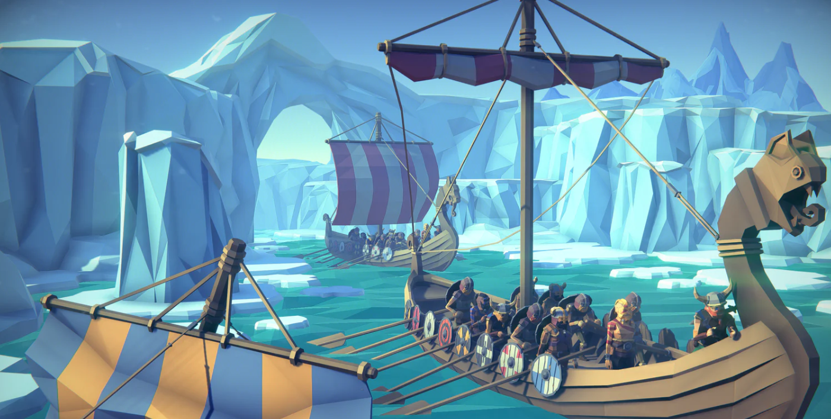
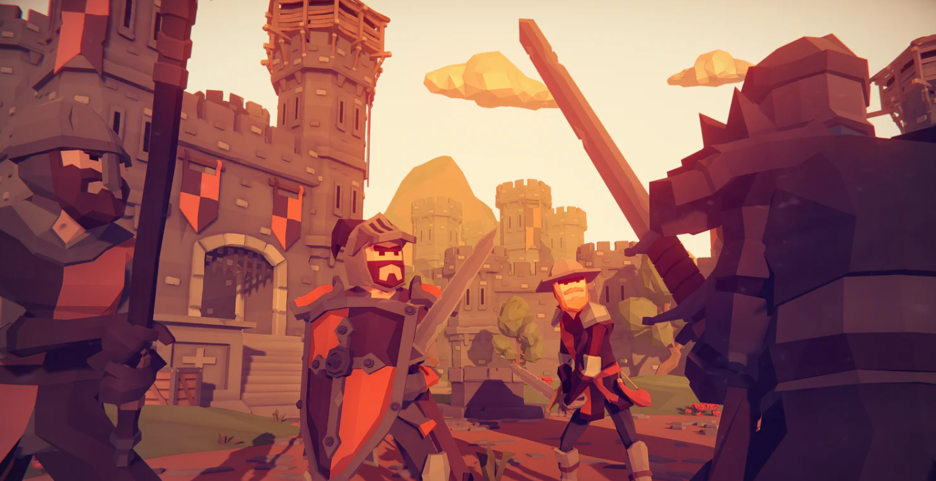
Crusadeon
Roguelite game with combat based on Hades and item & skill progression from Risk of Rain series.
You play as The Crusader, a revived warrior with a thirst for revenge
Art style is high resolution Lo-poly

Slide 5
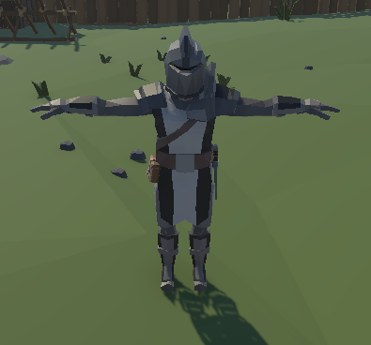
Revived by God with a mission to slay the Vikings (along with their heathen Gods)
Has access to 3 abilities
- Spear of Destiny (ranged attack)
- Sacred Wave (knockback ability)
- Judgment (AoE attack)

Slide 6
Design Challenge
Tag | Attributes
Form of solution | Roguelite game with fast-paced combat inspired by Hades combined with the item progression system from Risk of Rain series
Users | Players aged 16 and onwards
Context | With an affinity towards roguelite games
Perform Activities | To empower themselves with a plethora of items and slay Vikings
Target Performance | To enjoy a high adrenaline experience

Slide 7
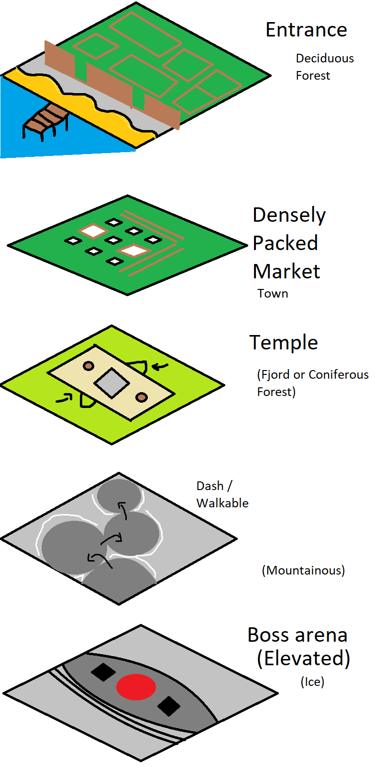
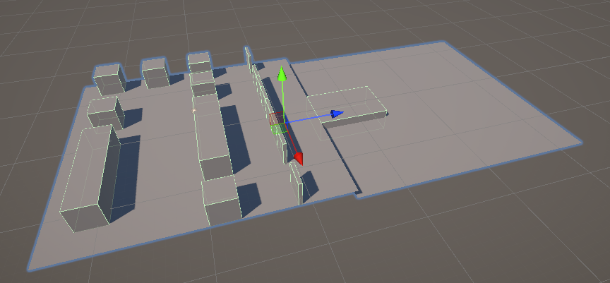
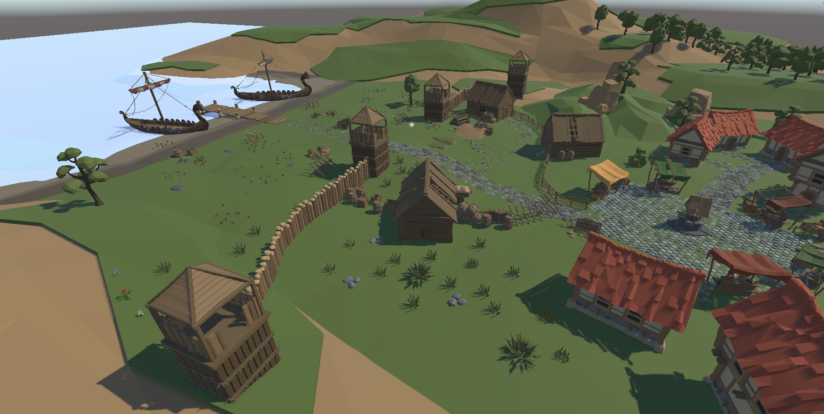
Level design

Slide 8

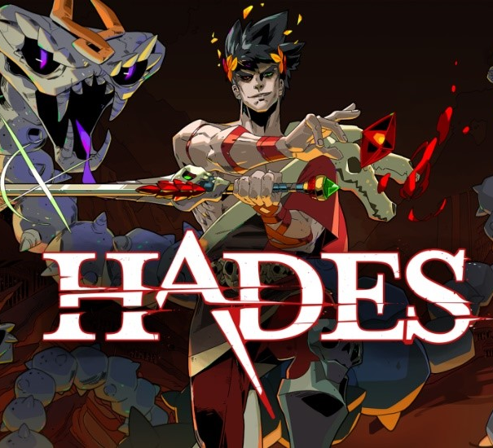

Inspiration: Combat
In Hades you always have access to 4 skills
Basic attack
Special attack
Cast (ranged attack)
Dash
Basic attack (3 hit combo)
Spear of Destiny (Ranged attack)
Sacred Wave (knockback ability)
Judgment (AoE attack)
Dash

Slide 9
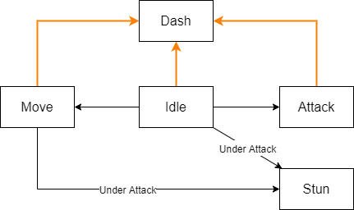
How can we make it “feel” like Hades?

Slide 10
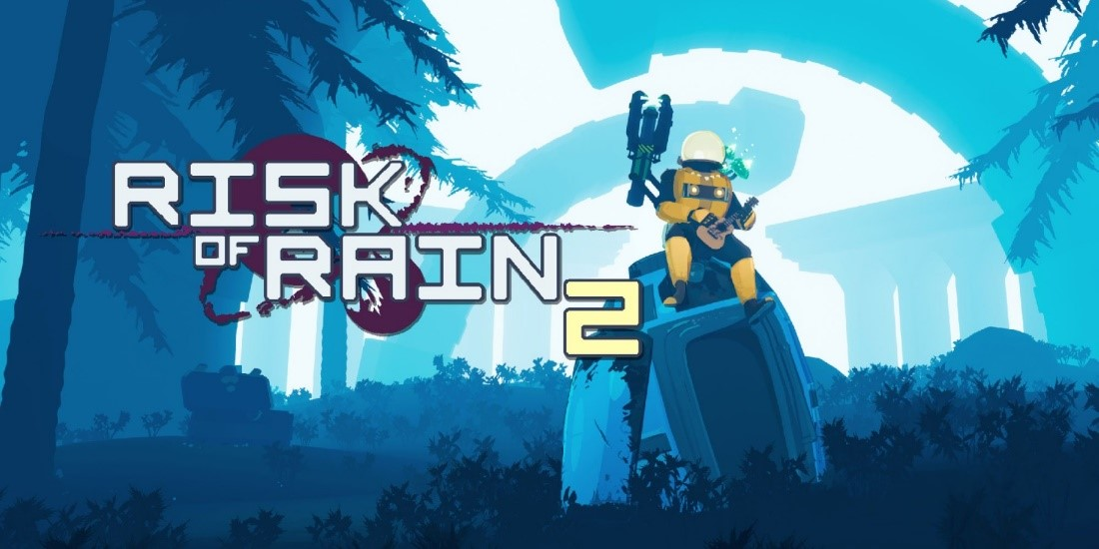
Inspiration: Item/Skill progression
Risk of Rain has approx. 186 different items along with 7 different rarities
Items can be split between 2 types; passive and active items
Crusadeon
Items can be split between 2 types; passive and active items

